Slide 1
AOP with Castle Windsor and PostSharp
Chris Canal
chris@e4ums.co.uk
http://twitter.com/chriscanal
http://blog.e4ums.co.uk

Slide 2
Agenda
What is AOP?
AOP with Castle Windsor
AOP PostSharp

Slide 3
What is AOP?
From Wikipedia:
“Aspect-oriented programming (AOP) is a programming paradigm that increases modularity by allowing the separation of cross-cutting concerns,”

Slide 4
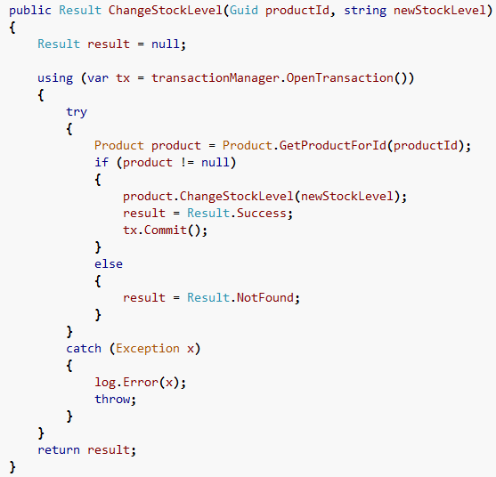
Scattering & Tangle

Slide 5
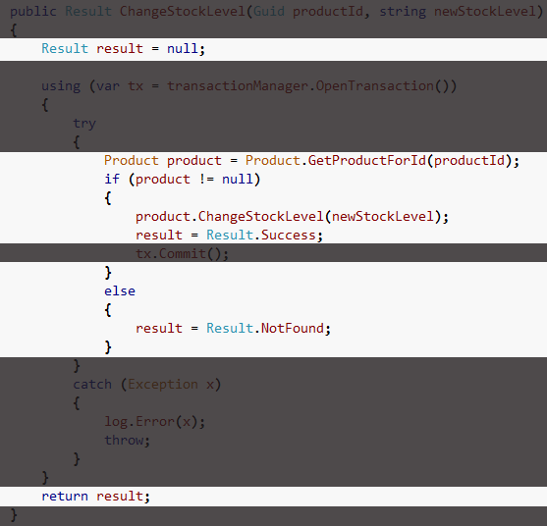
Scattering & Tangle
Core
Concern

Slide 6
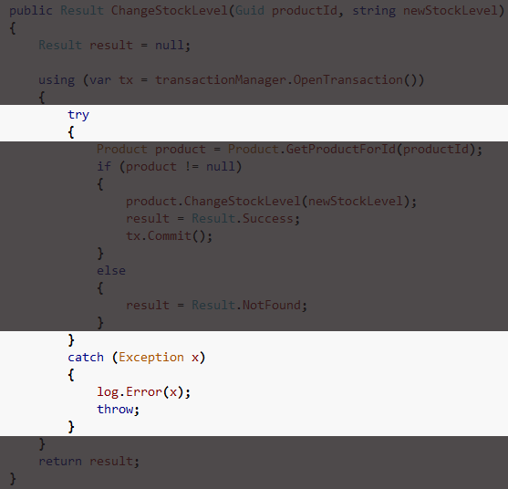
Scattering & Tangle
Exception
Handling

Slide 7
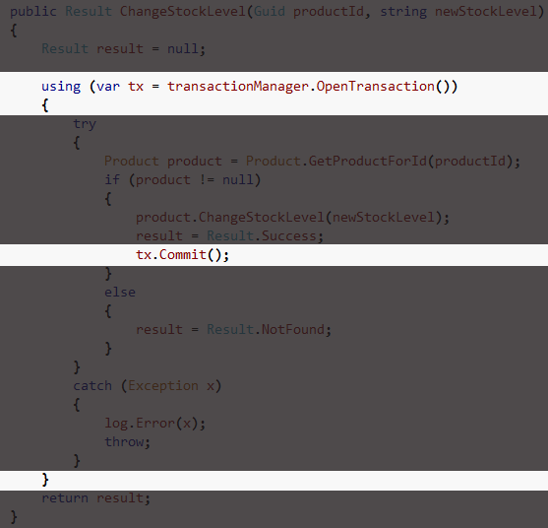
Scattering & Tangle
Exception
Handling

Slide 8
AOP Overview
Advice
Weaving
My Assembly
Advice Types
Pointcuts
Before
Join points
My Service
Around
Runtime
Method A
Throwing
Method B
Compile Time
After

Slide 9
AOP With Castle Windsor
Runtime Weaving

Slide 10
Castle
“Castle is an open source project for .NET that aspires to simplify the development of enterprise and web applications.”

Slide 11
DynamicProxy2
“Castle DynamicProxy is a library for generating lightweight .NET proxies on the fly at runtime. Proxy objects allow calls to members of an object to be intercepted without modifying the code of the class”

Slide 12
MicroKernel and Windsor
“Castle Windsor aggregates the MicroKernel and exposes a powerful configuration support. It is suitable for common enterprise application needs. It is able to register facilities and components based on the configuration and adds support for interceptors.”

Slide 13
AOP with Castle Windsor
Pros
No additional compiler step
Aspects can be added or removed dynamically
Might already be using Castle
Cons
Some overhead – runtime proxying
Join point model limiting “out of box”
Learning curve if new to Castle

Slide 14
Demo

Slide 15
Questions?

Slide 16
AOP With PostSharp
Compile Time Weaving

Slide 17
PostSharp
“PostSharp transparently inserts itself in the build process and post-processes the compiled assembly. Since PostSharp works at MSIL level, it supports virtually all static languages targeting the .NET Framework.”

Slide 18
PostSharp Laos
“...you can encapsulate these aspects as custom attributes. You can make your own custom attributes that will really add new behaviors to your code! This is sometimes called aspect-oriented programming...”

Slide 19
AOP with PostSharp
Pros
Better performance – compile time
Reasonable learning curve
Rich join point model
Cons
Additional compiler step
Static Weaving

Slide 20
Demo

Slide 21
Questions?

Slide 22
What is AOP?
From Wikipedia:
“Aspect-oriented programming (AOP) is a programming paradigm that increases modularity by allowing the separation of cross-cutting concerns,”

Slide 23
Agenda
What is AOP?
AOP with Castle Windsor
AOP PostSharp

Slide 24
References
http://www.castleproject.org/
http://castle.uservoice.com/
http://www.postsharp.org/

